Slide 1
Restore Information Management
Village Way, Bilston, Wolverhampton, WV14 0UJ

Slide 2
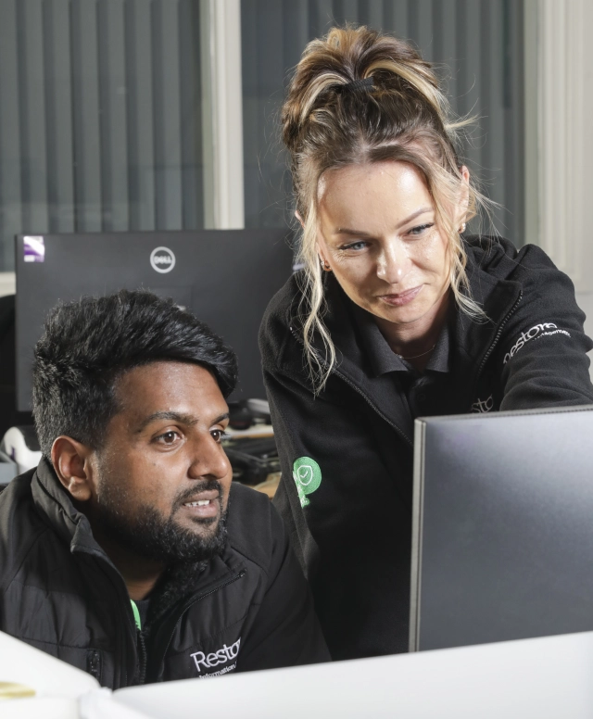
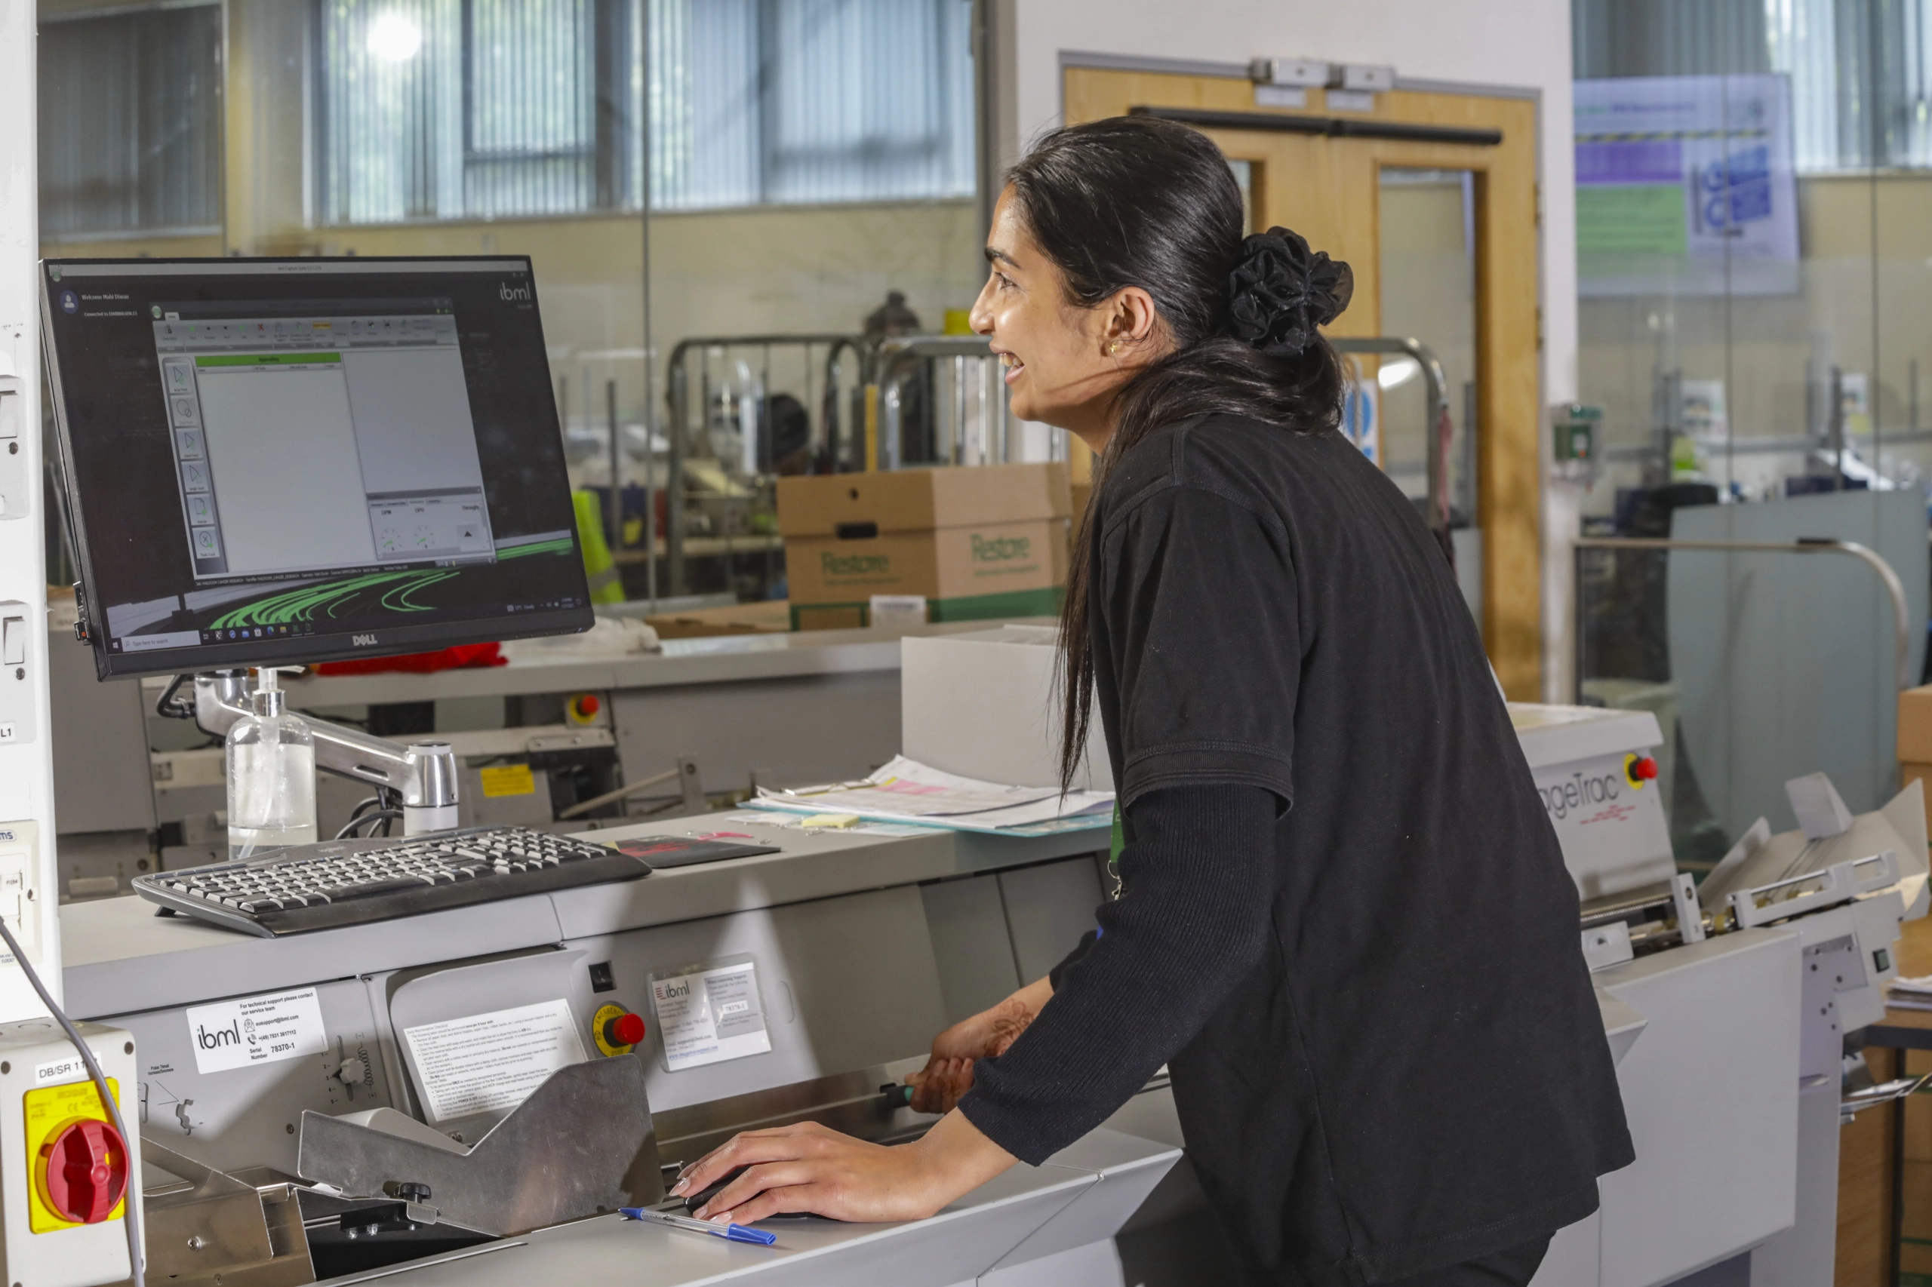
About Restore Information Management
A document management company specialising in digital transformation and storage
Who We Are
Restore information Management is the leading UK owned provider of information management services, specialising in secure physical document storage, scanning digital mailrooms, outbound communication, hosting and automated workflows.
Our approach helps organisations protect, transform and access their information seamlessly and efficiently. Weith a focus on innovation and customer-focused solutions, we help organisations streamline and manage their information to stay competitive in today’s fast-paced market.

Slide 3



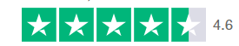



Fast Facts About Us
The largest UK owned Information Management company
Number of heads ~ 1,340
54 sites
nationwide
+ 6,900
customers
Over 1,000 TrustPilot reviews
50 million items scanned
1 million mail
items processed per month
755 million
items scanned
Notes:
755 million items scanned in the last three years
We need to get some Digital info to put in notes here from Samia
Make it clear what the Physical side of IM do and what the Digital side of IM do here in the notes
IM create 80% of the profits for Restore PLC so what we do matters.

Slide 4
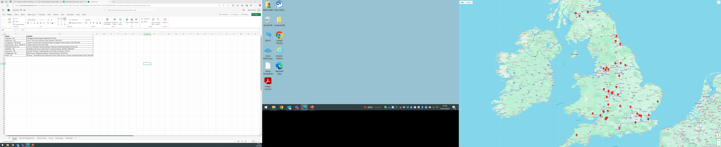
UK Locations
We have state-of-the-art facilities in over 50 locations across the UK, they include dedicated mailrooms, high-volume scanning hubs, and secure storage centres.
SW Midlands & NW
Monkton Farleigh
Neston/Westwood
Southampton
Launceston
Stroud
Berkeley
Newport
Avonmouth Tewkesbury
Birmingham
Hartlebury
Telford
Manchester
Heywood
Bedwas
Bilston
Planetary Road
Manchester x 2
Kidderminster
Central & South
Swadlincote
Coventry
Markham Vale
Upper Heyford
Dunstable
Ipswich
FCDO
Rainham
Barking
Walthamstow
Thurrock
Sittingbourne
Shoeburyness
North & Scotland
East Kilbride
Livingston x 2
Paisley
Durham
Washington
Spennymoor
Middlesbrough
Goole
Leeds x 3
Sherburn
Oldham
We also have sites in New York and Athlone

Slide 5







The Recruitment Journey
YOU ARE HERE!
APPLY FOR THE POSITION
ONBOARDED AND FIRST DATE
On your 1st day, you’ll meet your team, get set and start a structured onboarding journey to set you up for success
1.
INITIAL SCREENING
If shortlisted, you'll be contacted for a call to discuss your background and alignment for the role.
Hiring manager will decide if to progress your application to interview. Feedback will be provided to you by the recruiter
8.
2.
SECURITY SCREENING
You will receive an email from our screening team at GIANT to start the process of applying for security clearance (ADD CLEARANCE FOR SITE)
7.
INTERVIEW(S)
You’ll participate in one or more interviews (number of interviews will be confirmed at screening stage)
You will receive interview confirmation to your email with the details of your interview
3.
6.
4.
ONBOARDING
Once you accept, you will receive an email to log onto our Eploy system where you will find your contract and all new starter paperwork to read and sign.
5.
DECISIONS
After all interviews, we’ll review feedback and make a hiring decision. Your recruiter will contact you with the final decision.
OFFER STAGE
If selected, you will receive an offer confirmation via email and a start date will be confirmed.

Slide 6













Benefits and Rewards
Share Save Scheme
Holidays
Pension
Paid Volunteer Day
Access to our Mental Health First Aiders
Long Service Recognition
Eyecare Vouchers
Life Assurance
Retail Discounts
Bereavement Support
Family Leave
Employee Assistance
Refer a Friend Scheme
Cycle to Work Scheme
Apprenticeship Opportunities

Slide 7

What Else Can We Offer You?
Pay
Uniform / Dress Code
Communication
Monthly Pay –
  28th of every month
Electronic Payslips
ID cards to be provided and must be always warn onsite.
Operations
Unform and PPE (high vis jacket and steel toe capped boots) are provided by Restore for some of our roles. This will be discussed at interview stage.
Should PPE not be required for your role then pants/black jeans and t-shirt (no sports attire or shirts with offensive writing or logos on). In winter periods hoodies and fleeces are allowed.
Trainers are preferred or dolly shoes. But no open toe or back and no heels.
Back Office & Leadership
For all other roles our dress code is a smart casual appearance is required for on-site, remote work, video meetings, and events.
Regular Team Meetings
121’s
Company Intranet (Circle)
Colleague rep forums
Internal Social Media (Yammer)
Onsite Notice Boards
Your Say Engagement Survey
Careers Page
Restore Employee Portal
  Request and cancel holidays
  Change your personal details
  Employee handbook

Slide 8
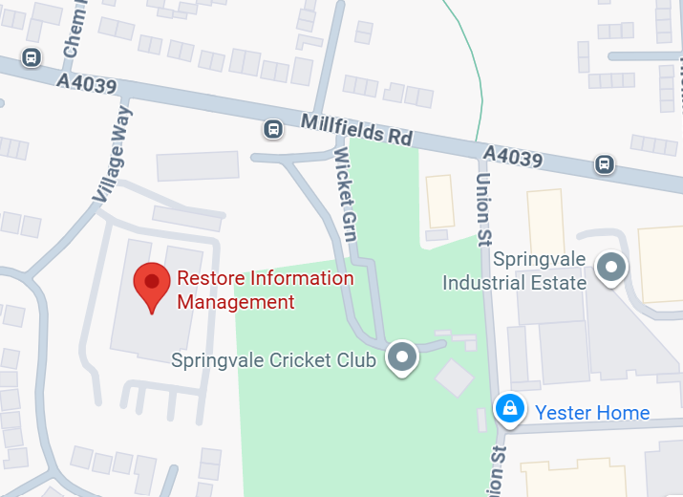
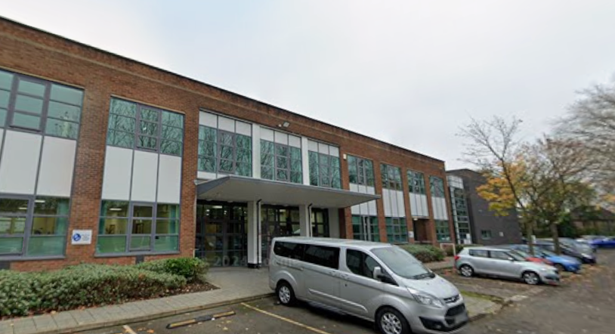
Site Information
Restore Information Management, Village Way, Bilston, Wolverhampton, WV14 0UJ
Free onsite parking
The nearest bus stop located right outside our site
There is a kitchen onsite which includes a kettle, microwave and fridge
There is a vending machine onsite for hot and cold drinks
Free tea, coffee, sugar, sweetener and milk is provided
There are tram stops located within a 20-minute walk from site
Bilston town centre is located a 15-minute walk away which contains a variety of supermarkets, shops and fast-food restaurants

Slide 9

Employee Testimonials
We Asked Current Employee’s What They Enjoyed About Working for Restore. Here Is What They Said
“Stress-free, decent pay, and we consistently had three breaks in an 8-hour shift. Very good people to work with, overall great experience. Highly recommended!”
Pros: Comfortable pace and positive colleagues.
“Great company that truly values its staff. Management recognise effort and contributions, which makes the work rewarding even when roles get repetitive.”
Pros: Staff value, recognition, positive team environment.
“A good, stable job – the training is acceptable, and colleagues are friendly. The team makes the work enjoyable, and progression is relatively straightforward. It’s steady work with no weekends.”
Pros: Welcoming environment and realistic expectations.

Slide 10
For further information please contact the Restore Information Management Recruitment Team
E: talent@restoreplc.com
T: 0330 912 1377

